Slide 1
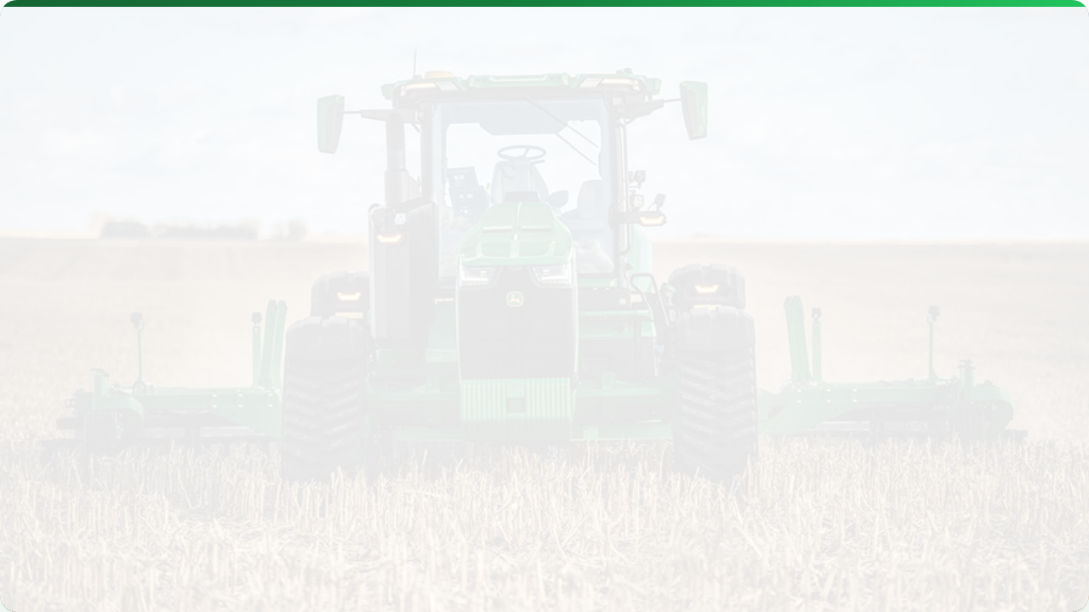



AGRICULTURAL ROBOTICS & AUTOMATION
Lecture 13: The Future of Farming
AGE 418
Dr. Kadeghe Fue

Slide 2




Lecture Roadmap
Fundamentals
Applications
Drivers for Automation
Weeding Robots
Levels of Autonomy
Harvesting Robots
Core Technologies (Perception, Actuation)
UAVs (Drones)
Swarm Robotics

Slide 3
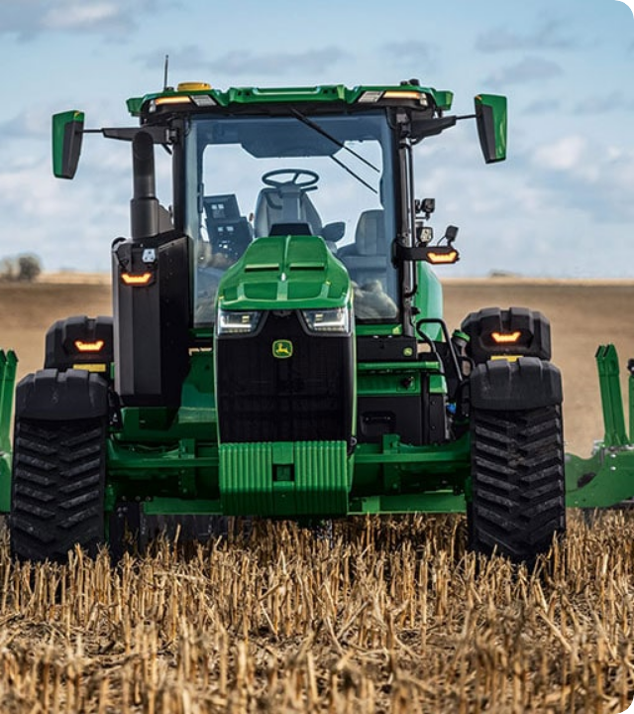
Why Robots?
The 3 D's: Dull, Dirty, Dangerous.
Robotics address critical industry challenges:
Labor Shortage: Aging workforce and rural migration.
Efficiency: 24/7 operation with consistent precision.
Sustainability: Reducing chemical use (Spot Spraying).

Slide 4



Levels of Autonomy
Level 0
Level 2
Level 5
Manual Control (No assistance).
Assisted (Auto-Steer, but driver in seat).
Full Autonomy (No cab, no driver).

Slide 5

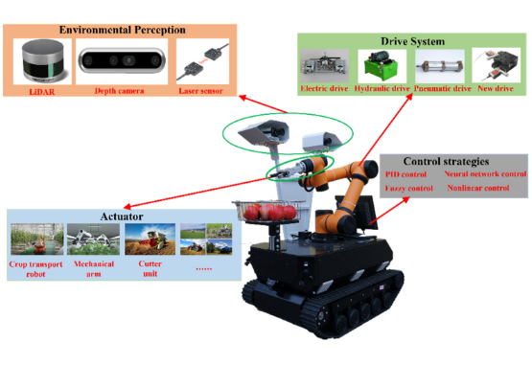
Anatomy of an Ag Robot
A robot is a system of loops.
Perception (Eyes): Cameras, LiDAR, GNSS, Ultrasonic.
Processing (Brain): AI/ML Algorithms, Path Planning.
Actuation (Hands/Legs): Wheels, Robotic Arms, Nozzles.

Slide 6




Application 1: Weeding
Moving away from broadcast spraying.
Mechanical
Chemical
Thermal/Laser
Hoes or blades physically remove weeds between rows.
Micro-sprayers target individual weeds (90% savings).
Zapping weed meristems with heat or light.

Slide 7
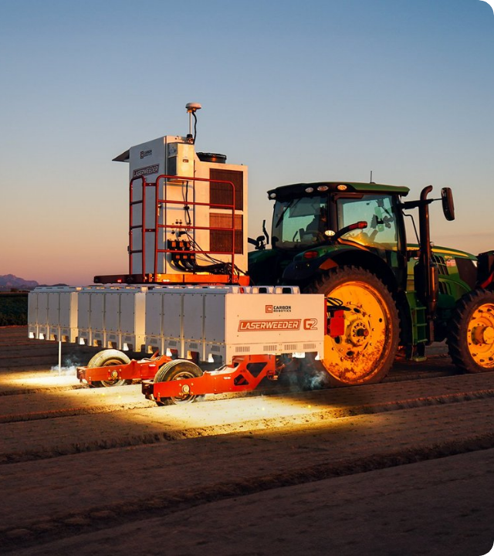
Laser Weeding
The Future of Organic?
The "Carbon Robotics" autonomous weeder uses thermal energy (lasers) to kill weeds without disturbing the soil.
Speed: 100,000 weeds per hour.
Vision: AI distinguishes crop from weed in milliseconds.

Slide 8
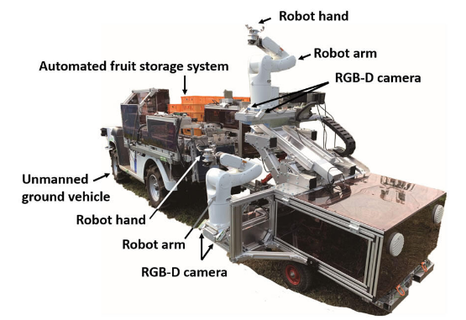
Application 2: Harvesting
The Hardest Challenge.
Unlike factories, fruits vary in size, shape, and location.
Challenges: Soft fruit bruising, leaf occlusion (fruit hiding behind leaves).
Tech: Soft grippers, vacuum arms, and stereo cameras.

Slide 9
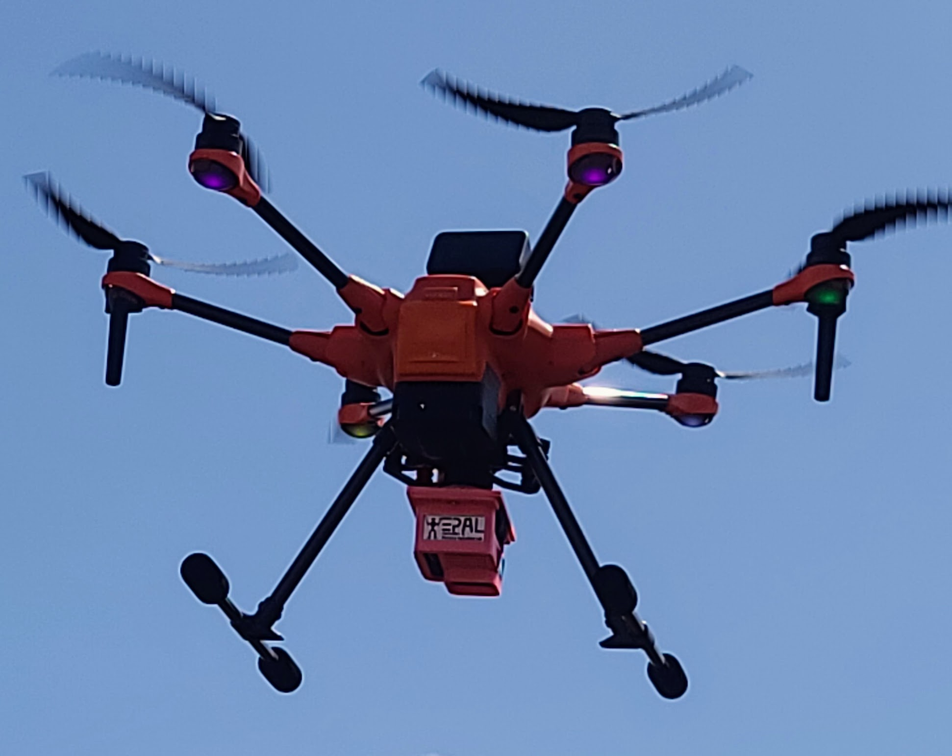

Application 3: UAVs
Unmanned Aerial Vehicles (Drones) are robots too.
Scouting
Spraying
Seeding
NDVI Mapping, Stand counts, Plant height.
Spot spraying in difficult terrain (hills, wet paddies).
Shooting seed balls for cover crops or reforestation.

Slide 10
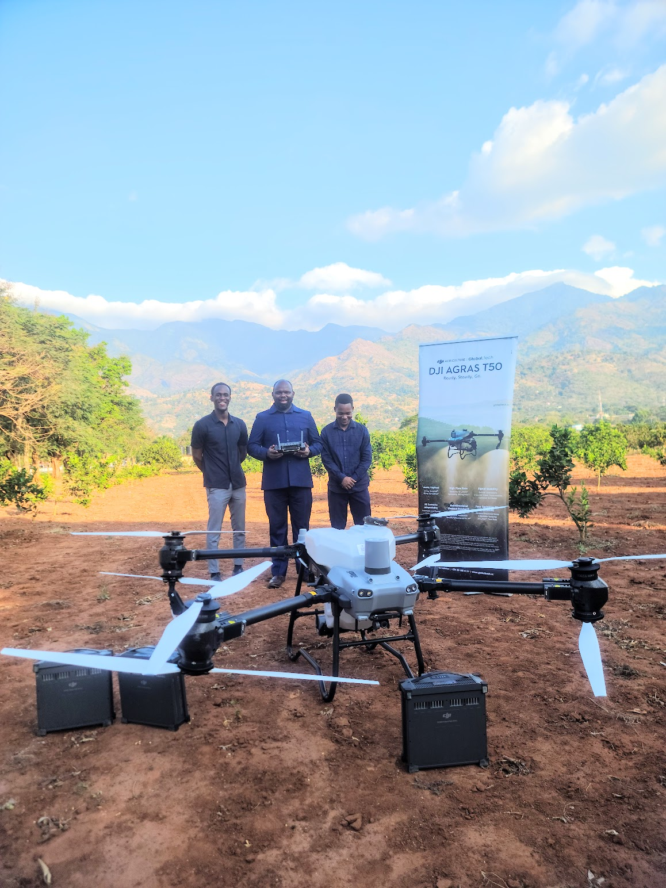
Spray Drones
Precision Aerial Application.
Efficiency: Uses high concentration, low volume (ULV).
Safety: Removes the operator from exposure to chemicals.
Terrain: Can fly over muddy fields where tractors get stuck.

Slide 11
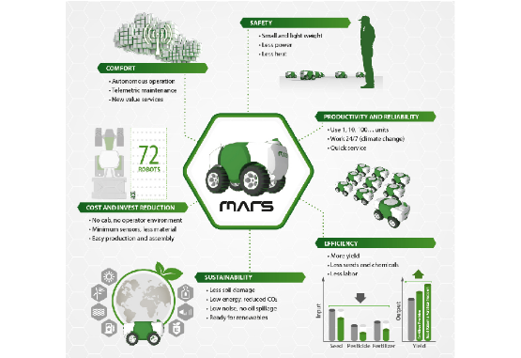
Concept: Swarm Robotics
Small > Big?
Instead of one massive 500HP tractor, use 10 small 50HP robots.
Redundancy: If one breaks, the others keep working.
Compaction: Lighter machines damage soil less.
Scalability: Buy robots as you grow.

Slide 12

Tractor-Implement Automation
ISOBUS Class 3 (TIM)
Tractor Implement Management. The Implement controls the Tractor.
Example: Baler Automation
The Baler tells the tractor to "Stop" when the bale is full, ejects the bale, and tells the tractor to "Go" again. Driver hands-free.

Slide 13
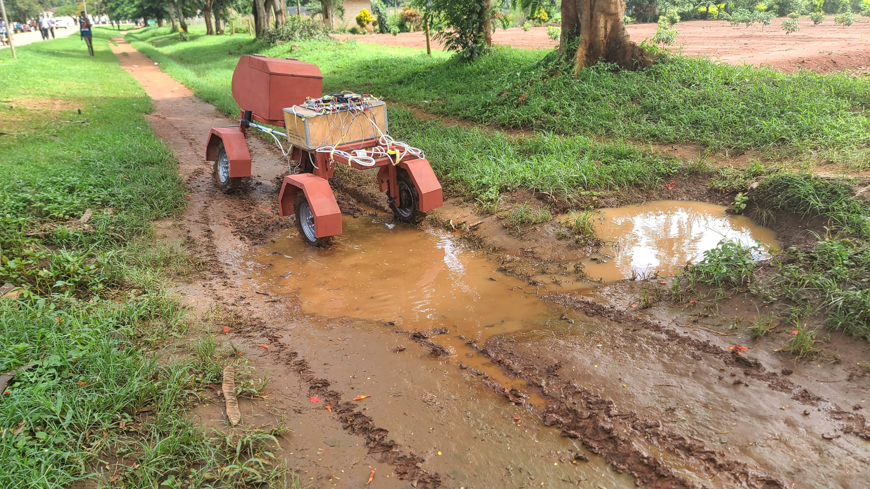

Robotics in Tanzania?
Is this relevant for us?
Drones: Already widely used for spraying (sugar cane) and mapping.
Small Robots: "Tertill" style weeders suitable for small horticultural plots.
Opportunity: Leaping over the "Heavy Mechanization" stage directly to "Smart Light Automation".

Slide 14
Challenges to Adoption
Challenge | Description
Cost | High initial investment vs unproven ROI.
Safety | Risk of autonomous machines hurting people/animals.
Complexity | Requires new skills (mechatronics, coding) to repair.
Connectivity | Robots need reliable internet/GPS in rural areas.

Slide 15
Future Trends
Energy
AI
RaaS
Shift to Electric/Solar robots (Diesel independence).
Smarter perception. Robots learning to "feel" fruit ripeness.
Robots as a Service. Farmers rent the capability, not the machine.

Slide 16


Lecture Summary
Robotics
Forms
Addresses labor shortages and increases precision (3 D's).
Ranges from Drones (Air) to Swarms (Ground) to Smart Implements.
Next Class: Lecture 14 - Economic & Environmental Impacts

Slide 17

Questions?
Dr. Kadeghe Fue | AGE 418
Sokoine University of Agriculture

